Slide 1
White Coat Ceremony Class of 2025

Slide 2
Arrive: 2:00 pm
YOUR WHITE COAT will be at the Capitol Theatre for you to pick up - Cleaned and pressed – Geneva, Karen, Joselin and Michon will be assisting with this.
Enter the Capitol Theatre from the 4th Street entrance (stage door) in the back.
You have received your Arnold P. Gold Foundation lapel pin, put it on your left lapel.
Please keep your personal items to a minimum – leave with family – there will be bins to backstage – to retrieve after ceremony.
Doors open at 2:30 pm for Family and Friends

Slide 3
Line Up: 2:45 pm
Line up as directed backstage
Drape your white coat over your left arm (nicely)
You will then proceed out the door and down the alleyway
You will be directed to the audience seats, about 34 per row
Remain standing until entire class has entered
There will be a program on your seat

Slide 4
Ceremony Begins: 3:00 pm
Dr. Scandalis, Dean, will open the ceremony and give his welcome message
Dr. Lawler, President, will speak
Vice Chair of the Board of Trustees: Mr. John Vornbrock
Student Speakers (2) Inspirational Thought – Raymandeep Aujla, OMS III and Andy Shang, OMS II, to recite the Class of 2025 Vision Statement & Class Motto.
Keynote Speaker: Marie Cadwell Meyer, DO, Assistant Professor of Family Medicine and Assistant Dean for Clinical Education, PNWU Inaugural Class of 2012
• After Dr. Cadwell Meyer concludes her speech the coating will begin
You will be directed to stand ONE ROW AT A TIME and move to the stage, leave your program at your seat, you will not be returning to the same seat

Slide 5
Coating
You will be instructed to stand (one row at a time) proceed as directed to the stairs at the base of the stage
When prompted, proceed to the podium and announce (speak directly into the microphone):
YOUR FULL NAME, YOUR HOMETOWN, and YOUR UNDERGRADUATE SCHOOL
Proceed to the center of the stage to be coated
Hint: left arm in coat; right arm in coat; right shoulder back to turn; then shake coaters hand
Left – Right – Turn to Shake Coater’s hand
Feel free to straighten your hair and coat as you proceed to be congratulated by
Dr. Scandalis
Shake hands with Dr. Scandalis.

Slide 6
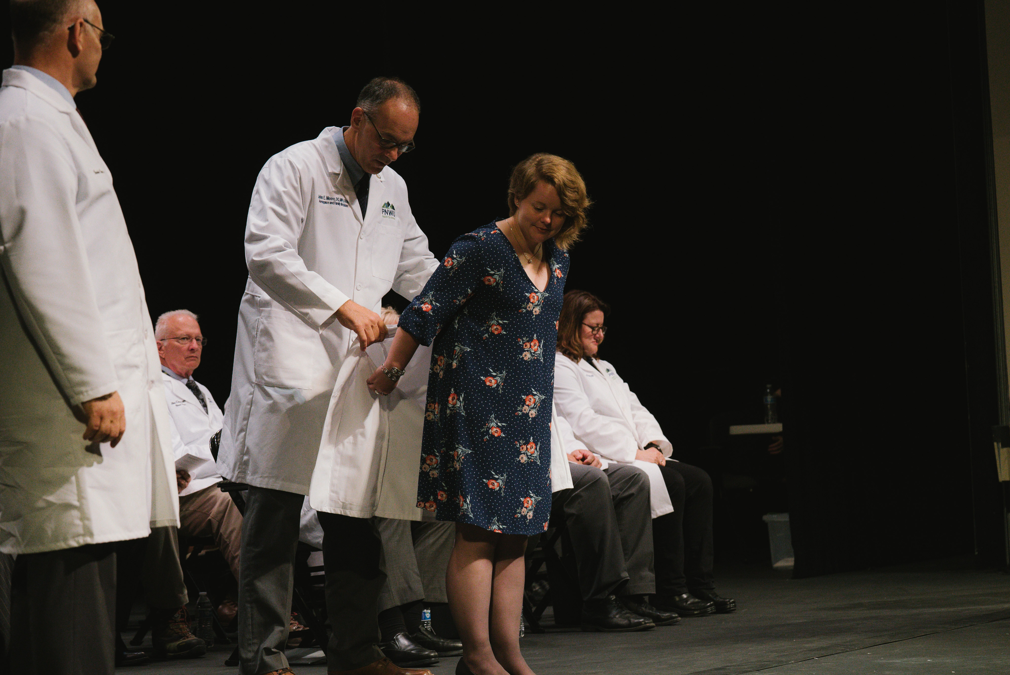

Slide 7
Exiting the Stage
After you shake Administrators’ hands, exit the stage and go down the stairs.
There will be someone there to direct you to your row.
You will not be returning to the same seat.

Slide 8
Ceremonial Oath:
When all students have been coated Dr. Scandalis will ask you to stand and lead you in the oath.
OATH IS LOCATED ON THE BACK OF YOUR PROGRAM
Read ALOUD with conviction!
Dr. Scandalis will conclude the ceremony
The recessional will begin, platform party, faculty and then the students will file out of the theatre

Slide 9
Tips
SILENCE YOUR CELLPHONE
Please refer to the website for proper attire suggestions: Professional dress.
Put the program as a tent over the seat.
Unbutton your white coat before being coated
When coated, put your arms straight back, low by your bum. Try not to turn around
Keep your personal belongings to a minimum, leave them with your family members
Wear shoes so you can navigate the stage stairs
Parking – tell family to arrive early to find parking – 3 lots: Olive Garden, S. Naches Avenue, East Walnut Avenue

Slide 10
NOW IT IS TIME TO PRACTICE!

Slide 11
Important Volunteers
Leading students in will be:
Tricia Worthington
Lynn DeVore/Kayla Epperly
Joy Allen/Gavin Kremian
T’erra Felder/Taylor Sieberman
Lesley Hunter/Katelyn Bonny
1st two rows please stand!

Slide 12
Congratulations
Enjoy the moment, this is a great achievement!

