Slide 1
How to make a payment in Self-Service
You can make a payment online in PowerCAMPUS Self-Service
Choose the Bank Account option for no fee (PNWU pays the small fee)
Choosing the debit or credit card option incurs a fee
Log in to Self-Service and get started! (<- Click)
Navigate to the “Finances” tab
Click on the “Balance” hyperlink
Select the “Period” (semester) you want to pay for and the “View” of what you want to see (usually “Balance Summary”)
On the lower left side, enter a dollar figure in the “Amount” field, click “Make a Payment”
Don’t worry about the “Apply Payment To” field; that drop-down menu is blank
The Payment Information pop-up window will appear; enter your bank account information and select “Continue”
LEARN. CARE. COMMUNITY.
PNWU.edu

Slide 2
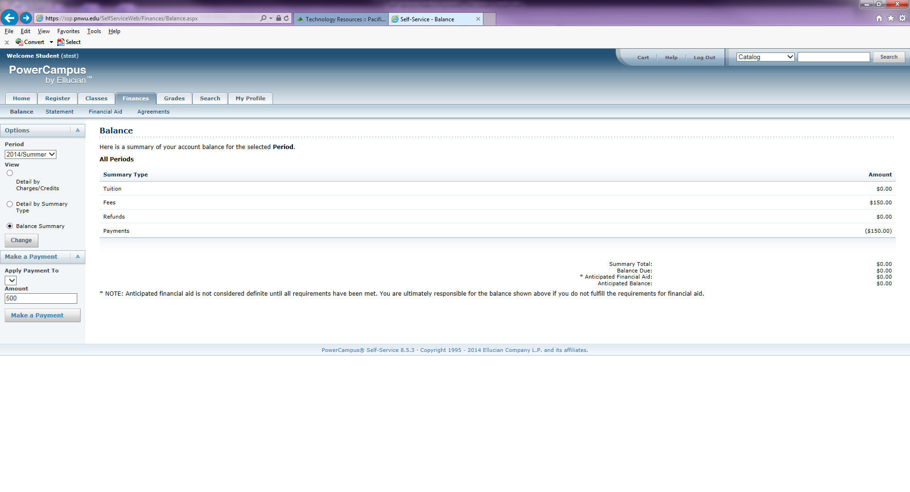
Screen shots of Self-Service
LEARN. CARE. COMMUNITY.
PNWU.edu

Slide 3
This is the payment screen. Disregard that it says “Application Fee”—we cannot change the wording. Any payment you make will go directly toward your balance owed on your PNWU student account.

