Slide 1
Precepting and Production Based Practices
Anita Showalter, DO, FACOOG (D)
Assistant Dean of Clinical Education
Associate Professor and Chief, Division of Women’s Health
Pacific Northwest University of Health Sciences
Notes:
Primarily focused on PNWU OMS Year 3 and 4
But can translate to all health care student training

Slide 2

Disclosure Information
There are no relevant financial relationships or any commercial interests
    Nothing to disclose

Slide 3
Educational Objectives
At the conclusion of this presentation, the participant should be able to:
Understand how a community based training model is designed.
Learn student, preceptor and institutional responsibilities.
Know ways to incorporate the student in the delivery of health care to save time.
Be familiar with how to utilize the student for medical scribing while protecting the rotation experience.

Slide 4
Why do we need this presentation?
Physicians are under more pressure for production in the clinic environment
There is a need to expand the physician workforce, specifically in rural and medically underserved areas
Physicians need to be the primary trainers of physicians in the clinical setting
Physicians are more likely to practice in the same areas they trained
Community based training models are necessary to meet this need
Strategies different from large university settings are essential to be successful in community training models
Notes:
Frequently asked questions from preceptors will also be addressed

Slide 5
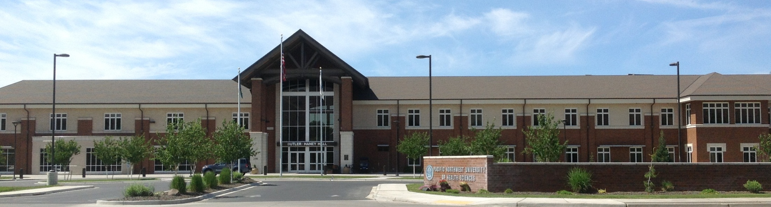
The Mission of PNWU-COM
Pacific Northwest University of Health Sciences
College of Osteopathic Medicine educates and trains students to become health care professionals with osteopathic values, and conducts research to provide quality care to communities of the Pacific Northwest, particularly rural and medically underserved populations.

Slide 6
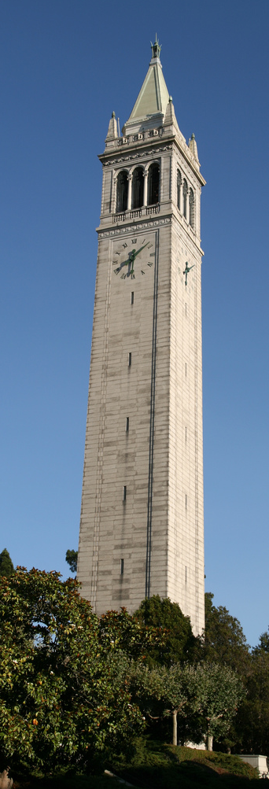
Community vs University Training
Community Model
Preceptor is a mentor
Volunteer or small stipend
Opportunities for learning are maximized when they arise
Just in time learning
Student directed learning with the course syllabus to guide
Patient encounters more typical to daily practice
Students become more comfortable with community practice
University Model
Preceptor is an academician
Salaried for the position
Learning occurs by a set schedule
Significant time in structured didactics
Institutionally directed learning
Patient encounters likely to include rare conditions or exotic diseases
An ivory tower of sorts. Sather Tower, U.C. Berkeley.
Photo by Bernt Rostad. Creative Commons

Slide 7
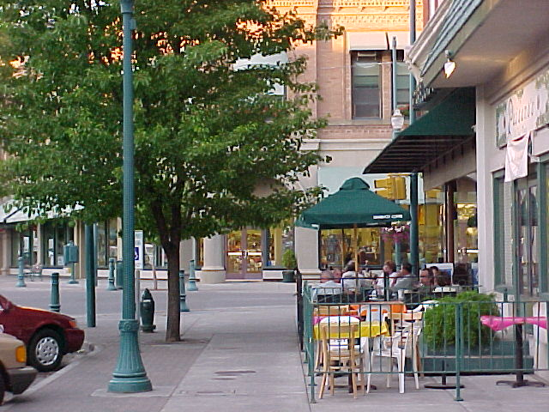
What is community training?
Physicians open their practices to trainees
Students carry more responsibility to direct learning opportunities
Physicians act as mentors, not professors
Principles of clinical reasoning are modeled by the preceptor
The model of how clinical learning takes place has changed because of outside forces (government regulations and funding, EHR’s, third party payors)
http://wikitravel.org/upload/shared//thumb/4/45/Wallawalla.jpg/380px-Wallawalla.jpg

Slide 8
Community-Based Education:
Advantages for the Student
The student:
observes the role of the physician in a community
sees how physician engagement can make a difference in health care delivery with limited resources
becomes a contributing part of the health care delivery team
is “first in line” for procedures and patient care opportunities
learns how regional referral systems can benefit patients in more rural settings

Slide 9

Community-Based Education:
Advantages for the Preceptor
The preceptor:
is reminded of the reasons for choosing their profession
stays up to date as they teach and answer questions
gains increased credibility in the community and with peers with an adjunct faculty appointment
Saves time by having students do meaningful tasks
Patient satisfaction scores increase
PNWU offers access to CME through
TeachingPhysician.org and local presentations
www.publicdomainpicture.net
Notes:
Paid subscription to TeachingPhysician.org provided by PNWU to Approved ACF
AOA Category 1-B CME for Precepting provided by PNWU for eligible ACF
Additional Faculty Development, CME, and other resources (library access) available

Slide 10
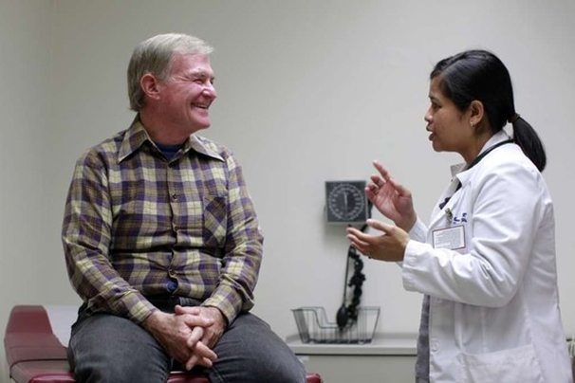
Advantages to the Patients
Patients feel heard and taken care of when they spend more time with the students
Many patients enjoy the opportunity to be “professor” for the day
Patients benefit from having physicians that are current in by being involved in teaching
Patients can help recruit physicians to
the community
Students can assist in patient education with
time to answer questions
scienceroll.com

Slide 11
Students as Medical Scribes – Assisting the Preceptor While Protecting the Rotation Experience
PNWU students receive scribe training during their first two years of didactics
CMS does not restrict the use of scribes in the clinical setting
Students can scribe notes on the patients they see with the physician
The preceptor can scribe while the student examines a patient to critique H&P skills
Students can act as scribes to document notes while orienting to the clinic or to help catch up if the physician gets behind
While the student is primarily their as a learning, scribing helps teach the student clinical reasoning skills
Policies must be in place to permit medical student scribing
PNWU has sample policies and macros for use by partners

Slide 12
Community-Based Training:
Ongoing Challenges
Factors that commonly affect preceptor selection of patients for medical student teaching¹:
  time and efficiency
  educational value for the student
  potential influence of teaching on the doctor-patient relationship
Barriers to participation:
  lack of access to appropriate educational space and resources
  lack of access to educational specialists
  inadequate institutional support
¹Simon SR, Davis D, Peters AS, Skeff KM, Fletcher RH. How do precepting physicians select patients for teaching medical students in the ambulatory primary care setting? J Gen Intern Med. 2003 Sep;18(9):730-5. PubMed PMID: 12950482
Notes:
What is the best way to meet the medical needs of the patient, to meet the educational needs of the student, and to leave both feeling they have been well-served by the encounter?
Several strategies for clinical precepting have been described in the medical education literature, each with unique strengths and best suited to certain types of educational encounters.

Slide 13
Precepting Students in a Production Based Model
How to train students and stay on time – The wave method
Physician | 3rd Year Student | Physician | 4th year Student
9:00 Patient 2 | Patient 1 | 9:00 Patient 2 | Patient 1
9:15 Patient 3 |  | 9:15 Patient 3
9:30 Patient 4 |  | 9:30 Finish 1
9:45 Finish 1 |  | 9:45 Patient 5 | Patient 4
10:00 Patient 6 | Patient 5 | 10:00 Patient 6
10:15 Patient 7 |  | 10:15 Finish 4
10:30 Patient 8 |  | 10:30 Patient 8 | Patient 7
10:45 Finish 5 |  | 10:45 Patient 9
28 patients seen in 7 hours – student sees 7
30 patients seen in 7 hours – student sees 9

Slide 14
Community-Based Training:
Effective Strategies
Some methods have been shown to improve educational processes and outcomes
  Problem Oriented Precepting
  The One-Minute Preceptor (OMP)
  SNAPPS
  CAARE MORE
  Activated Demonstration
  Aunt Minnie
Cayley WE Jr. Office Precepting – Efficiency education and evidence. Family Medicine Digital Resource Library; 201. http://fmdrl.org/2691. Accessed July 13, 2015

Slide 15
Problem-Oriented Precepting Method
The Educational Process Made Explicit
Identify initial impressions
Confirm or refute these impressions
Identify the problem
Develop teaching goals
Devise methods to achieve these goals
Evaluate outcome
Esposito V, Schorow M, Siegel F. A problem-oriented precepting method. J Fam Pract. 1983 Sep;17(3):469-73. PubMed PMID: 6886649.
Notes:
“Problem-oriented” precepting is described as a means to address educational barriers that prevent the learner from providing high-quality patient care.
When a student is not providing care at the level expected, the first step is to identify impressions as to the source of the problem.
Second, observations and teaching encounters should be used to test, confirm, or refute these impressions.
Third, the educational problem (eg, knowledge deficit, learning methods, etc) is identified.
Fourth, once the problem is identified teaching goals are developed.
Fifth, teaching methods appropriate to reaching those goals are identified.
Sixth, the outcome of these teaching methods is assessed for learner progress.
This model essentially makes explicit the educational process that many preceptor may take for granted, and reminds the preceptor that addressing areas for educational growth requires more than just an immediate response to first impressions.

Slide 16
One-Minute Precepting Method
The 5 Microskills Approach
Get a commitment
  “What do you want to do?”
Probe for supporting evidence
  “What factors did you consider in making that decision?”
Teach general rules
  Mini-lecture? Suggested or assigned reading?
Reinforce what was done right
Correct mistakes
  Feedback: case-specific, behavior-focused, descriptive
Notes:
In the early 1990s the “one-minute preceptor” strategy was developed to combine several key “microskills” for teaching.
Use of this approach can improve residents’ teaching skills, improve efficiency of precepting, and improve the preceptors’ ability to diagnose the patient based on the learner’s presentation.
This approach is particularly recommended for new clinical teachers. – but it may be helpful to focus on developing one skill at a time, rather than attempting to undertake mastery of all the skills at once.
Get a commitment: Ask questions like “What do you want to do?” or “If I weren’t here, what would you do for the patient?” It can encourage the learner to begin processing and synthesizing the information collected.
Probe for supporting evidence: Probing for supporting evidence can help the preceptor understand the student’s fund of knowledge and analytic processes and identify areas for further learning. Helpful questions include “What factors did you consider in making that decision?” or “Were there other options you considered and discarded?”
Teach general rules: This is applicable to the case at hand and can help the student understand further how to apply general medical reasoning and principles to individual cases (a “mini-lecture” or suggested reading)
Reinforce what was done right
Correct mistakes
- Reinforcing what was done right, and correcting mistakes, are both important pieces of feedback to the learner. As with all feedback, it should be case specific, behavior focused, and descriptive rather than evaluative.

Slide 17
SNAPPS Method
Learner-Led Education
Summarize relevant H&P
Narrow the differential: Likely? Relevant?
Analyze the differential
Probe the preceptor
Plan patient management
Select a case-related learning issue
Wolpaw TM, Wolpaw DR, Papp KK. SNAPPS: a learner-centered model for outpatient education. Acad Med. 2003 Sep;78(9):893-8. PubMed PMID: 14507619
Notes:
The SNAPPS approach was developed based on cognitive learning and reflective practice theory. This approach seeks to turn the precepting encounter into a student-led, active learning experience. The SNAPPS acronym derives from the six steps of the process. (Box B) First, after evaluating the patient the student is asked to SUMMARIZE, generally in 3 minutes or less, the relevant history and physical findings. Second, the student is asked to NARROW the differential diagnosis, or the possible interventions, to the two or three most relevant and likely possibilities. Commitment to an initial decision on the part of the student, prior to preceptor input, is a key part of this teaching strategy. Third, the learner should ANALYZE the differential by comparing and contrasting the possible explanations. This allows the learner to verbalize his or her thinking process, and can stimulate interaction with the preceptor. Fourth, the learner is asked to PROBE the preceptor by asking about uncertainties, difficulties, or other approaches. This allows the preceptor insight into the learner’s thought process and knowledge base, and teaches the student to see the preceptor as a knowledge resource. Fifth, to PLAN management of the patient, the learner initiates a discussion with the preceptor by attempting either a brief management plan or suggesting specific interventions and then further refining these with preceptor input. Lastly, the learner is asked to SELECT a case-related issue for self-directed learning and reading, with preceptor input as needed to help focus the question or select learning resources. (B) One study found that when preceptors were trained in SNAPPS, compared to preceptors given no specific educational instructions or just general instruction on feedback, there was minimal difference between the three groups in average length of precepting encounters (approximately 5 minutes). However, students using SNAPPS were more concise in their summaries, presented more than twice as many diagnostic possibilities, and justified their diagnostic possibilities more often. SNAPPS students also performed better at contrasting hypotheses, expressing uncertainties, initiating discussion of management, and identifying learning topics. (C)

Slide 18
CAARE MORE Method
Mnemonic to address the psychosocial elements of care
Connect personally with the learner
Ask psychosocial questions
Assess the learner
Role model desired attitudes, skills, and behaviors
Environment: Create a safe, supportive, enjoyable learning setting
Management: Formulate specific management strategies
Observe the learner’s affect and behavior
Reflect and provide feedback
Educational resources
Kern DE, Branch WT Jr, Jackson JL, Brady DW, Feldman MD, Levinson W, Lipkin M Jr; General Internal Medicine Generalist Educational Leadership Group. Teaching the psychosocial aspects of care in the clinical setting: practical recommendations. Acad Med. 2005 Jan;80(1):8-20. Review. PubMed PMID: 15618086.
.
Notes:
Educating learners to appropriately, yet efficiently, address the emotional, psychological, and social elements of patient care is challenging in a busy clinical practice. A faculty development program in general internal medicine produced a mnemonic that can provide helpful structure and guidance for both the clinician and the learner in addressing the psychosocial elements of patient care. The CAARE MORE mnemonic (Box C) reminds the preceptor to focus on connecting personally with the student, to then both ask psychosocial questions and assess the student’s attitudes and skills, to role-model appropriate skills and attitudes, and to establish a safe learning environment. Other important elements are working on management strategies for psychosocial issues, observing the trainees affect and behavior, providing reflective feedback, and providing both educational resources and best evidence. This memory tool can help guide the preceptor in remembering key tasks and steps in teaching care of psychosocial issues.

Slide 19
Activated Demonstration Method
Teaching a Skill
Assess student’s relevant knowledge
Determine what the student should learn from the skill demonstration
Guidance for student participation during skill demonstration
Demonstrate the clinical skill
Discuss learning points with the student
Set an agenda for future learning opportunities
Wilkerson L, Sarkin RT. Arrows in the Quiver: evaluation of a workshop on ambulatory teaching. Acad Med. 1998 Oct;73(10 Suppl):S67-9. PubMed PMID: 9795655
Notes:
While knowledge and analytic thinking processes can be taught either in the examination room or separately in a precepting encounter, hands-on skills involving physical examination or procedural interventions require the preceptors’ presence in the patient room, demonstration, supervision, and feedback. “Activated demonstration” has been described as one way for a preceptor to maximize the educational value of a demonstration and provide the student with more than just a passive experience. Activated demonstration begins with determination of the student’s relevant knowledge and what the student should learn from the demonstration. The preceptor then provides clear guidance as to what the student should do during the skill demonstration, including discussions with and examination of the patient. After the skill demonstration, the preceptor discuss learning points with the student and set an agenda for future learning opportunities. This approach emphasizes assessment of and addressing the learner’s individual needs in order to maximize the educational value of the teaching encounter.

Slide 20
Aunt Minnie Method
The Value of Pattern Recognition
Student presents the chief complaint and the presumptive diagnosis
Student begins a write-up and preceptor evaluates the patient
Preceptor discusses case with student
Preceptor reviews and signs medical record
For this approach to be effective and clinically appropriate, the preceptor must see the patient, and the preceptor must either know the correct diagnosis or be willing to admit uncertainty
Cunningham AS, Blatt SD, Fuller PG, Weinberger HL. The art of precepting: Socrates or Aunt Minnie? Arch Pediatr Adolesc Med. 1999 Feb;153(2):114-6. PubMed PMID: 9988240.
Notes:
Most clinical teaching methods focus on a critical-thinking discussion between the student and preceptor, and at least a brief exploration of diagnostic or management options. In contrast, the “Aunt Minnie” has been described as a way to educationally employ the value of pattern recognition in clinical practice.
So named for the principle that “If the lady across the street walks like your Aunt Minnie and dresses like your Aunt Minnie, she probably is your Aunt Minnie”, this approach has been advocated actually representing the typical approach applied by most clinicians for common ambulatory problems.

Slide 21

How does a student fit into a busy practice?
On the first day, have someone from the office give the student a tour of the facility and explain basic operations
Give the student the usual schedule and expectations of participation
Exchange phone numbers and preferred means of contacting each other
Determine if there will be on call responsibilities
The student should follow the preceptor’s schedule up to 80 hours weekly
Give the student responsibilities that provide for independent activities.
  It is not expected that the student will just shadow the preceptor for the rotation period.
http://commons.wikimedia.org/wiki/File:The_Stethoscope,_Peru.jpg

Slide 22
What kind of responsibilities can the student be given?
Review the next day’s schedule and pick out interesting patients
  The staff calls the patient to ask permission to have the student to a full history and physical
  The patient knows to plan for more time
  Let the student take the full history, perform the physical with the student, and have the student write a full SOAP note
Notes:
Before deciding what strategy to use and when, it is important to assess both the student and the clinical day and decide on an overall approach for the day at hand.
Starting a day of clinical teaching with a review of upcoming patients and likely diagnoses can help with setting expectations for the student and the clinical staff, and planning for efficient use of time.
Is the day expected to be busy or light? Which scheduled patients are well-established, or returning for follow-up on specific concerns, and perhaps more likely to want their visit to be mainly with their physician?
Which patients are new, to the clinic or to the physician, and so perhaps more likely to provide an opportunity for the student to have a “fresh start” on a clinical problem?
Which patients are likely to have diagnoses new to the student, or diagnoses the student would benefit from seeing for the first time?
Negotiating expectations and a precepting plan with the student is also important.
Is it important for the student to be involved, at some level, in all the patient visits of the day, even if much of this is simply shadowing?
Or is it important for the student to have a more independent role in a smaller number of visits?
When is the student best served by the opportunity to assess or negotiate plans with patients independently, with relatively less preceptor time in the examination room?
When is the student better served by direct preceptor observation of the student’s clinical skills, with the preceptor in the examination room while the student works?
Regulatory and reimbursement issues need to be considered relative to the degree of direct preceptor involvement that is required in each clinical encounter for supervision of procedures, documentation, and billing.

Slide 23
What kind of responsibilities are appropriate for the student?
Let the student see one patient while the preceptor sees several
  The preceptor returns with the student to complete the visit
  Let the student writes up the visit while the preceptor sees several more
  Students may see 6-8 patients daily in this manner while the preceptor is getting other work done
Students can do osteopathic manipulation with the preceptor’s supervision
- patients appreciate this added benefit

Slide 24

More student responsibilities:
When doing hospital care, the can student pre-round and gather all labs and data
Students may document the patient history and review of systems in the chart (if permitted by your institution).
  For billing purposes, physical findings must be documented by the physician
Have the student do a literature/text review for complicated or interesting cases
Students are very current on “zebras” and sometimes may pick up more obscure differential diagnoses that may present
www.publicdomainpictures.net

Slide 25
Clerkship Learning Objectives
The syllabus will be emailed to the preceptor with the student information when a rotation is scheduled
A quick review of the “Must See Cases”, or student learning objectives will inform the preceptor of the learning objectives for the rotation
The student’s responsibility is to augment rotation opportunities with reading and modules for deeper understanding and to learn about cases not seen on the rotation
If opportunity presents to explain some conditions more in-depth, students appreciate learning how a physician approaches them
The student’s job is to learn to “think like a doctor”

Slide 26
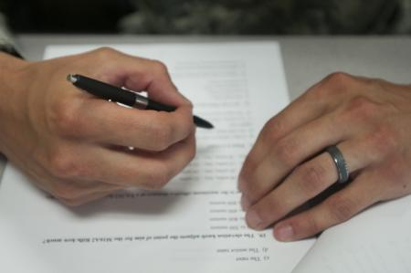
Evaluation of the Student
A brief mid-rotation evaluation form is used to encourage a conversation on how the student is doing
  Any significant areas of deficiency should be noted so the student has time to make corrections
An end of service evaluation is emailed one week before the end of the rotation.
  The preceptor is encouraged to fill this out as part of a discussion of the student’s strengths and weaknesses
The online evaluation takes 5-10 minutes to complete
A paper version is available for those not using email
Constructive comments are important for the
development of young future colleagues
www.dvidshub.net

Slide 27

End of Service Examination
Each student is required to complete and pass an end of service rotation examination
  COMAT: Comprehensive Osteopathic Medical Achievement Test
  The exams are purchased from the National Board of Osteopathic Medical Examiners (NBOME)
  This is scheduled through PNWU
  The exams are taken locally, preventing the need for significant student travel
  Our students currently score at or above the national mean on these exams.

Slide 28
Evaluation of the Rotation
Students fill out an end of service evaluation on the rotation and on the preceptor
To protect student confidentiality, individual comments are not shared with the preceptor
The Regional Dean may share a printed composite evaluation of three or more students, or may share verbally at any time
Improving skills as an educator and preceptor can be done through faculty development modules on TeachingPhysician.org.

Slide 29
What if I get a student that’s a poor fit?
> 50% of PNWU students obtain the highest scores possible in professionalism and communication on their rotations
Even with good students, personality conflicts or other situations can make work in a specific office difficult for the preceptor and/or student
Communication to alert the Regional Dean is requested as soon as possible when a significant problem is identified
  PNWU’s Assistant Dean of Clinical Education, the Regional Dean, and the preceptor will determine if the situation is correctable or if the student should be taken off the rotation

Slide 30
What about compensation…
$$$
PNWU is a private institution with primary funding through tuition dollars and personal donations
  We strive to keep tuition costs down to reduce debt and encourage entry into primary care specialties
PNWU offers a stipend for third year core rotations as a token of appreciation for student training
Physicians who donate their time to train students are honored as Physician Champions
Master Preceptors are committed to full-time teaching and learn how to be an effective preceptor
  Physicians may opt to donate their time to help us reduce costs

Slide 31
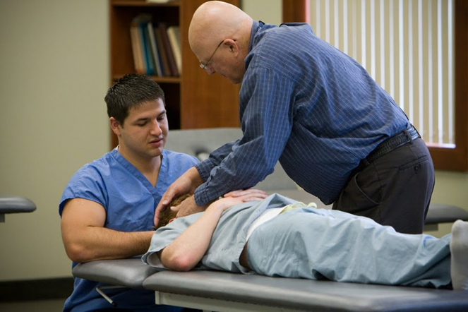
I’m an MD, can I train an osteopathic student?
Absolutely
  The skills of examination and creating a differential diagnosis are the same for MD’s and DO’s with the exception of structural examination and somatic dysfunction diagnoses
  MD’s can permit students to perform techniques that are widely considered safe for students
  MD’s can learn how to do OMT
Faculty development opportunities
are available to learn more about
osteopathic practice and manipulation

Slide 32
Interprofessional Education and Collaboration
IPE: When students from two or more professions learn about, from, and with each other to enable effective collaboration and improve health outcomes. (WHO 2010)
IPC: When multiple health workers from different professional backgrounds work together with patients, families, careers, and communities to deliver the highest quality of care. (WHO 2010)
Notes:
Recommend common core competencies relevant across professions to address the essential preparation of clinicians for interprofessional collaborative practice.
Recommend learning experiences and educational strategies for achieving the competencies and related objectives.

Slide 33
Interprofessional Collaborative Practice
Developing students as future interprofessional team members
Training students to learn from and work with:
  Fellows and Residents
  Nurses, Physician Assistants, Pharmacists
  Social Workers, Case Managers
  Other Allied Health Professionals
Photo Credit Libby Frost/University of Minnesota Family Medicine and Community Health
Notes:
Why is this important right now?
Create coordinated effort across health professions
Guide curricular development to achieve outcomes
Provide foundation for IP development across learning continuum
Ground evaluation and research to advance integration of IPE
Stimulate dialogue between education and practice
Identify opportunities to address accreditation requirements in content/practice areas
Evolve common language across accreditation standards

Slide 34
Core Competencies for
Interprofessional Collaborative Practice
Competency Domain 1:
  Values/Ethics for Interprofessional Practice
Competency Domain 2:
  Roles/Responsibilities
Competency Domain 3:
  Interprofessional Communication
Competency Domain 4:
  Teams and Teamwork
How care is delivered is as important as
what care is delivered
Interprofessional Education Collaborative Expert Panel. (2011). Core competencies for interprofessional collaborative practice: Report of an expert panel. Washington, D.C.: Interprofessional Education Collaborative.
Notes:
Recommend common core competencies relevant across professions to address the essential preparation of clinicians for interprofessional collaborative practice.
Recommend learning experiences and educational strategies for achieving the competencies and related objectives.

Slide 35
Building a Framework for Collaboration
Work in Interprofessional Teams
  Core Competencies
Provide Patient-Centered Care
  Health promotion
  Safer, timelier, more effective, efficient, and equitable
Apply Quality Improvement
  Improving institutional and clinical effectiveness
  Population Health
    Chronic diseases that link to a community context
Employ Evidence-Based Practice
Utilize Informatics
Notes:
What are the requirements for educating health professionals to practice in health delivery teams?
What are the obstacles to educating health professionals to practice in health care delivery teams?

Slide 36
Visit pnwu.edu to get started
Learn about available resources for Adjunct Clinical Faculty (ACF)
  www.pnwu.edu/college-osteopathic-medicine/adjunct-clinical-faculty-development/
Complete an ACF application
  www.pnwu.edu/files/5814/3144/9427/Adjunct_Faculty_Application_updated_3_10_15.pdf
Locate PNWU rotation sites and meet our faculty
  www.pnwu.edu/college-osteopathic-medicine/curriculum/clinical-rotations/
  Speak to your local Regional Dean about getting a student on your schedule
Join the growing faculty at PNWU who are
training the future physician workforce
for the Pacific Northwest!

Slide 37
Suggested Readings
McCormick LH. Precepting preclinical students. Fam Med. 1999 Apr;31(4):235-6. PubMed PMID: 10212760.
Seibert C, Haq C. Precepting preclinical students. Fam Med. 1999 May;31(5):313-4. PubMed PMID: 10407706. Irby DM, Wilkerson L. Teaching when time is limited. BMJ. 2008 Feb16; 336(7640):384-7. PubMed PMID: 18276715.
Dobbie AE, Tysinger JW, Freeman J. Strategies for efficient office precepting. Fam Med. 2005 Apr;37(4):239-41. PubMed PMID: 15812687
Lillich DW, Mace K, Goodell M, Kinnee C. Active precepting in the residency clinic: a pilot study of a new model. Fam Med. 2005 Mar;37(3):205-10. PubMed PMID: 15739137
Stephens MB. AHLTA: teaching medical students without falling behind (or, another take on the five microskills of precepting). Fam Med. 2007 Sep;39(8):540-1. PubMed PMID: 17764036
Neher JO, Stevens NG. The one-minute preceptor: shaping the teaching conversation. Fam Med. 2003 Jun;35(6):391-3. PubMed PMID: 12817861.
Furney SL, Orsini AN, Orsetti KE, Stern DT, Gruppen LD, Irby DM. Teaching the one-minute preceptor. A randomized controlled trial. J Gen Intern Med. 2001 Sep;16(9):620-4. PubMed PMID: 11556943.
Salerno SM, O'Malley PG, Pangaro LN, Wheeler GA, Moores LK, Jackson JL.Faculty development seminars based on the one-minute preceptor improve feedback in the ambulatory setting. J Gen Intern Med. 2002 Oct;17(10):779-87. PubMed PMID: 12390554.
Aagaard E, Teherani A, Irby DM. Effectiveness of the one-minute preceptor model for diagnosing the patient and the learner: proof of concept. Acad Med.2004 Jan;79(1):42-9. PubMed PMID: 14690996.
Irby DM, Wilkerson L. Teaching when time is limited. BMJ. 2008 Feb16;336(7640):384-7. Review. PubMed PMID: 18276715.

Slide 38
Questions?
Email rotations@pnwu.edu

