Slide 1
Welcome
Introduction to PNWU
Anita Showalter, DO, FACOOG (D)
Associate Dean for Clinical Education
Associate Professor and Chief of Women’s Health
Pacific Northwest University of Health Sciences
College of Osteopathic Medicine
Marc G. Cote, DO, FACOI, FACP
Assistant Dean for Clinical Education
Associate Professor of Internal Medicine
Pacific Northwest University of Health Sciences
College of Osteopathic Medicine
Elizabeth McMurtry, DO, FACEP
Assistant Dean for Clinical Education & Faculty Development
Pacific Northwest University of Health Sciences
College of Osteopathic Medicine

Slide 2
PNWU.edu

Slide 3
Linking Medical Education to your Community
Recruit
Educate
Return
PNWU MISSION
Pacific Northwest University of Health Sciences educates and trains health care professionals emphasizing service among rural and medically underserved communities throughout the Northwest

Slide 4
Notes:
This date will be updated again by 9/15/2018

Slide 5
We are proud that over 78 percent of our students are
from the Northwest and almost half are from
rural or medically underserved areas.
PNWU-COM
Most of our Students are from* our 5-State Catchment Area
2008 - 2017 (N=1083)

Slide 6
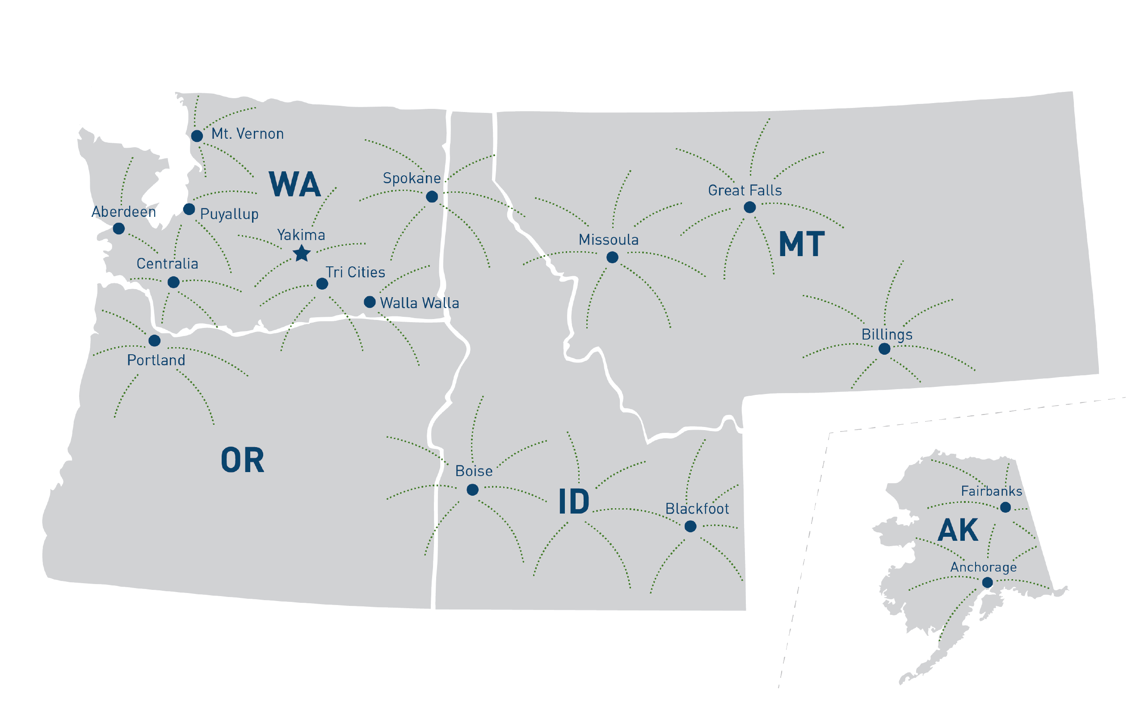
PNWU Clinical Rotation Sites
For 3rd & 4th Year COM Students

Slide 8
Notes:
(Students Eligible to Match and that Participated in and Completed the Residency Match Process)

Slide 9
CLASS OF 2012, 2013, AND 2014
Where they came from
Where they did residency
Where they are practicing

Slide 10
Matriculation Location
This map indicates where the PNWU-COM classes of 2012, 2013, and 2014 came from.
80% were recruited from the Northwest.
87% were recruited from a rural or medically underserved area.

Slide 11
Residency Location
This map indicates where the PNWU-COM classes of 2012, 2013, and 2014 fulfilled their residency.
60% were in primary care.
63% were in residencies outside of the Northwest.

Slide 12
Alumni in Practice
This map indicates where the PNWU-COM classes of 2012, 2013, and 2014 have returned to practice.
75% are practicing in the Northwest.
51% are practicing in Washington.
60% are practicing in rural or medically underserved areas.

Slide 13
Interprofessional Collaborations
PNWU
HU
CWU
WSU
Yakima Valley Interprofessional Practice and Education Collaborative (YVIPEC)
Our Mission:
Our mission is to promote the highest quality of health care through creating a culture of inclusive and collaborative interprofessional education, scholarship, and practice.
Our Vision:
Our vision is that health care professionals will practice collaboratively to achieve better overall health for their communities.

Slide 14
Questions?

